Slide 1

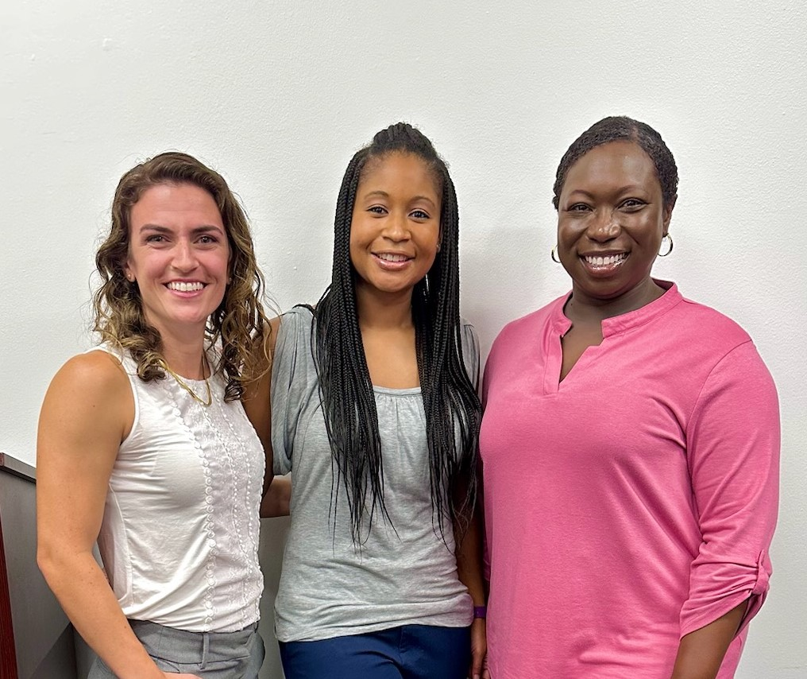
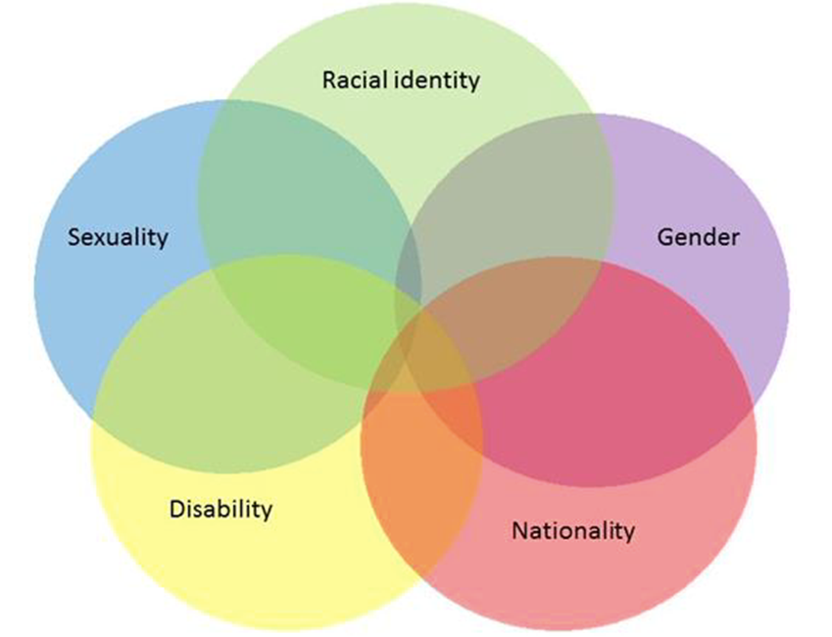


The Atlanta Initiative: Community-based Care Model for LGBTQ+ and Black Breast Cancer Survivors
Authors: Janae Finley, PT, DPT, Physical Therapist, TurningPoint Breast Cancer Rehabilitation, Atlanta; Hannah Afify, PT, DPT, Physical Therapist, TurningPoint Breast Cancer Rehabilitation, Atlanta; Mallory Mark, PT, DPT, Physical Therapist, TurningPoint Breast Cancer Rehabilitation, Atlanta; Marlena Murphy, APC, NCC, Mental Health Counselor, TurningPoint Breast Cancer Rehabilitation, Atlanta; Joan Rau, LMT, Massage Therapist, TurningPoint Breast Cancer Rehabilitation, Atlanta
Background/Methods:
Significant disparity exists in the diagnosis, treatment, and survivorship outcomes among Black breast cancer (BC) survivors
Unmet physical and emotional needs in BC survivors are well documented, but there is mounting evidence that Black BC survivors have more significant survivorship issues and a greater burden of illness than their White counterparts
Barriers to rehabilitation and recovery care exist for all BC survivors but are magnified in Black survivors due to systemic racism, healthcare provider bias and discrimination, lack of culturally relevant care models, and socio-economic barriers
Compared to heterosexual women, sexual minority cisgender women (SMW) experience increased stigma, discrimination and violence; decreased access to healthcare; increased prevalence of health risk behaviors; and increased rates of adverse health outcomes
Compared to white SMW, racial/ethnic minority SMW face increased minority stress and increased health disparities
Despite mounting evidence regarding the benefits of specialized cancer rehabilitation, implementation is often challenged by limited health facilities, inadequate health promotion, and lack of specialized providers
The Atlanta Initiative provides significant insight to the physical therapy community as a model for providing sustainable, equitable and intersectional care to marginalized communities and additional insight in the many remaining opportunities for growth
The findings provide compelling documentation of lived personal and professional experiences of racial and gender disparities in BC survivorship. These issues have been described in the literature for nearly two decades. Potential solutions exist and must be enacted immediately to ensure equitable survivorship outcomes for Black and LGBTQIA+ individuals following a BC diagnosis.
Presented by Janae Finley, PT, DPT, CLT, CES and Hannah Afify, PT, DPT, CLT, CES
jfinley@myturningpoint.org
hafify@myturningpoint.org
TurningPoint Breast Cancer Rehabilitation
A non-profit 501(c)(3) organization in Atlanta, GA
Results: Patient Quotes
“ The Atlanta Initiative is important for me because it is a safe space for me to be open and honest about my cancer journey. Whether it is addressing the pain my body may be going through, to financial hardships, or just needing a shoulder to cry on, having someone who has walked this walk to comfort me and tell me that its normal makes me feel less crazy”
“It is important to me because bringing therapy to downtown Atlanta helps the patients that don’t have affordable care and transportation be able to receive the proper breast cancer therapy then need”
“The Atlanta initiative’s additional focus on serving LGBTQ+ persons adds another dimension of support- a clear message of acceptance and respect. When I’m already feeling so challenged by the demands of recovery, the last thing I want to be worrying about is discomfort, ignorance, stigma, or discrimination.”
“Many African Americans have limited access to rehabilitation clinics that increase the likelihood of returning back to day-to-day activities. TurningPoint’s clinic in Atlanta is important to African American communities because it provides proper care and great resources, and gives us the confidence we need to fight against cancer”
Results: Elements of Success
TAI meets the needs of Black and LGBTQIA+ individuals going through breast cancer in metro Atlanta
To date, 68 Black women have been provided with 1,036 individualized physical therapy appointments and 14 LGBTQIA+ patients have been provided with 137 individualized physical therapy appointments
Key elements of success of TAI included developing a strong community coalition, that represents the Center for Black Women’s Wellness, Grady Hospital Cancer Center and rehabilitation department, community stakeholders and members of the Atlanta faith community
Additional factors include the tireless work of our Community Advocate and marketing efforts of the clinical team
Patients served at TAI also demonstrate statistically significant improvements in overall shoulder ROM, decreased pain levels, and increased subjective report of function
Methods:
In an effort to create a community-based care model to address known disparities that exist, TurningPoint Breast Cancer Rehabilitation created The Atlanta Initiative (TAI)
TAI is a project of the GAP Initiative with the goal of reducing disparity in breast cancer survivorship among Black and LGBTQIA+ individuals in Atlanta
The initiative incorporates principles of health justice, community engagement, patient empowerment, and culturally concordant care bringing specialized rehabilitation directly into the community it serves
TAI works alongside the community to directly impact Black and LGBTQIA+ breast cancer survivors, reduce survivorship care barriers and facilitate expansion of community resources
Discussion: Importance to Rehab Professionals
​Comprehensive models of care that include rehabilitation have been shown to significantly improve physical functioning, quality of life, activities of daily living and activity participation
These community-based models of evidence-based care have been piloted in Atlanta, GA, Detroit, MI, and Monroe, LA
TAI has provided significant insight to the physical therapy community as a model for providing sustainable, equitable and intersectional care to marginalized communities
The authors have no conflicts of interest. The findings and conclusions in this report are those of the authors and do not necessarily represent the views of the Centers for Disease Control/the Agency for Toxic Substances and Disease Registry.
Notes:
Poster Template using Individual Text Boxes

